Slide 1
BUPT Subjective Test
Liu Yitong, Liu Hao, Shen Yun, Li Yuchen,
Ran Yu, Wang Zhe
liuyitong@bupt.edu.cn
WT&T Lab @ BUPT

Slide 2
Outline
Subjective Test Summary
- 107 videos tested, 64 testers involved
Test Results Filtering
- according to ITU-R BT.1788[2]
Model Validation and Comparison
- between the results of BUPT and UCSD
Data Analyze

Slide 3
Subjective Test Summary
Goal：Validate the accuracy of UCSD overall user experience model:
R = f(I_{ID}, I_{ST}, I_{LV})
Impairment due to Initial Delay
Impairment due to Level Variation
Impairment due to Stall
C₁ | C₂
0.17 | 0.31

Slide 4
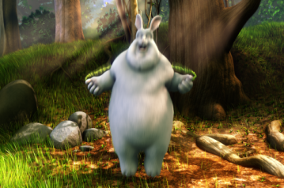

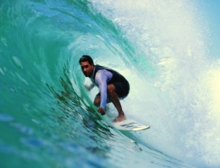
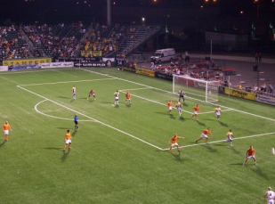
Subjective Test Summary
107 videos, including BunnyCartoon(11), Movie(48), Sport(48).
BunnyCartoon
Movie
Sport
Medium motion
High motion
Video | Amount | Motion | Test factors
BunnyCartoon_Stall_1-11 | 11 | Medium | Stall
Movie_Case01-48 | 48 | Medium | All factors*
Sport_Case01-48 | 48 | High | All factors
All factors*: stall, initial delay, and level variation

Slide 5
Subjective Test Summary
64 testers are divided into 3 groups (Form * 1, 2, 3 ).
Each video clip obtains at least 21 votes.
Each tester watches about 45 test video clips in one hour.
Evaluation methodology: Single-Stimulus (SS).
Equipment model | Ipad4
Resolution | 1280*768*
Touchscreen type | Capacitive screen
Screen size | 9.7 inch
Amount | 3
* Resolutions and forms are similar to UCSD’s.
Notes:
单激励法：在单激励法中，显示单一的图像或一个图像序列，并为评价者提供一份整个演示的索引。测试素材可以只包含测试序列，也可以既包含测试序列，又包含其相应的基准序列。对于后一种情况，基准序列作为一个单独的激励显示，并像其它测试激励那样进行评分。

Slide 6
Test Results Filtering
Our Goal : to ensure the accuracy of the subjective results.
MCT : Max Correlation Threshold, in single-stimulus model, MCT=0.7
GT :Give-up Threshold, PCC :Pearson Correlation Coefficient, SPRCC : Spearman’s Rank Correlation Coefficient.
After filter，52 participants are kept out of 64.
Reference : ITU-R BT.1788[2].
Notes:
:测试的所有相关者相关的平均值。
std(r)：测试的所有观测者相关的标准差。

Slide 7
Model Validation & Comparison(1-1)
Differences between BUPT’s test process and UCSD’s.
64 testers from BUPT participate in the subjective test, 25% more than UCSD’s.
Result filtering according to ITU-R BT.1788 were made to guarantee the accuracy of subjective results.
A pre-test is conducted to ensure our test plan feasible. .
More testers involved and more strict standards adopted, the test results may agree better with the actual subjective scores.

Slide 8
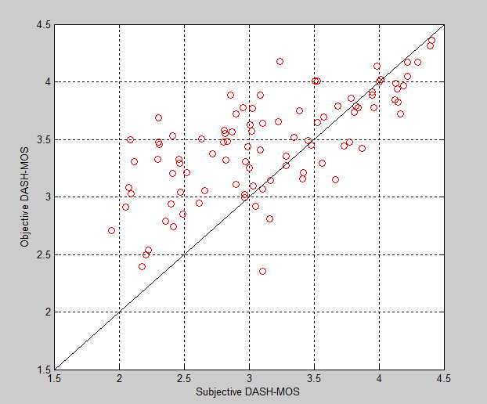
Model Validation & Comparison(1-2)
All(96) Video Clips’ Result
Result of BUPT
PCC : 0.6998
MSE : 0.5895
Result of UCSD*
PCC : 0.91
MSE : 0.082
*:60 videos are for training, and rests are for validation.

Slide 9
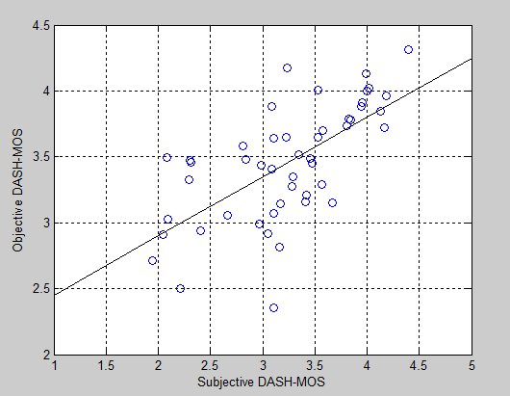
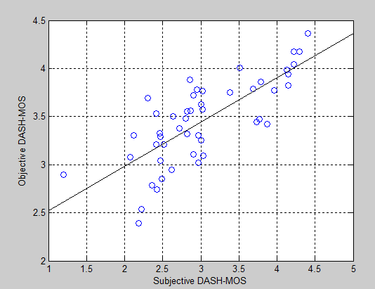
Model Validation & Comparison(2)
Test Results of BUPT
Conclusion : The model provides higher correlation in medium motion than in high motion.
48 Movie Videos
(medium motion)
PCC : 0.7593
MSE : 0.6419
48 Sport Videos
(high motion)
PCC : 0.6530
MSE : 0.5302

Slide 10
Model Validation & Comparison(3)
Before Filter
After Filter
PCCs of Movie, Sport and All drop.
MSEs of Movie, Sport and All increase.
 | Movie | Sport | All
PCC | 0.7972 | 0.6819 | 0.7340
MSE | 0.5526 | 0.4706 | 0.5133
 | Movie | Sport | All
PCC | 0.7593 | 0.6530 | 0.6998
MSE | 0.6419 | 0.5302 | 0.5895

Slide 11
Data Analyze
Joint Factors: Initial delay、Stall duration and Stall number.
initial delay stall | 1s | 3s | 6s | 10s
Stall-2s/2 | 66.477 | none | 61.211 | 62.638
Stall-8s/2 | none | 59.256 | 58.453 | 56.67
Stall-12s/4 | none | 56.465 | 54.066 | 54.395
Initial delay could impact user experience only when there’s obvious difference in its length, such as from 1s to 10s.
R varies distinctly under the impact of Stall duration and Stall number.
Notes:
初始时延这一因素的影响较小，只有在初始时延的时长相差较大时，我们才可以明显的看出R分差；
卡顿这一因素的影响较大，卡顿时间从2s到8s变化时，R产生明显的变化，且卡顿次数与时间同时变化时R也产生了明显的变化。

Slide 12
Data Analyze
Joint Factors: Initial delay and Bit rate variation.
Initial delay Level | 1s | 6s | 10s
Level-10 | 93.75 | 88.5 | 82.15
Level-24 | 70.01 | 58.35 | 61.35
Level-30 | 59.2 | 54.3 | 60.15
Level-34 | 56.26 | 50.55 | 49.88
R varies dramatically with the variation of Bit rate.
Bit rate has a larger influence on overall video score compared with initial delay.

Slide 13
Data Analyze
Factors: Stall Duration and Stall Number.
We draw the same conclusion with UCSD.
What is the definition of Medium Stall?
How many stalls can be described as “a few” or “a lot”?
Video ID | 1 | 2 | 3 | 4 | 5 | 6 | 7 | 8 | 9 | 10 | 11
Total Duration | 4sec |  |  | 8sec |  |  |  | 12sec
Stall Number | 1 | 2 | 4 | 1 | 2 | 3 | 8 | 1 | 3 | 6 | 12
R | 89.93 | 85.13 | 81.68 | 81.8 | 82.05 | 80.1 | 71.63 | 72.3 | 74.05 | 68.43 | 58.75
I_{ST}(a few medium stall ) < I_{ST}(a long stall) < I_{ST}(a lot of short stalls)

Slide 14
Problems
PCC and MSE aforementioned show that our test results don’t agree with the UCSD Model very well.
UCSD uses 60% of their experiment results for training, and the remaining 40% for verifying. Has they made iteration?
We have no original test results of 3 factors : I_{ID}, I_{ST}, I_{LV} .

Slide 15
Next Step Plan
Revalidate the 3 factors : I_{ID}, I_{ST}, I_{LV} respectively.
Recalculate I_{LV} : Replace the formula of I_{LV} with our own algorithm.
文献名称？
Recalculate I_{ID} : UCSD’s Model considers that when stall and level variation artifacts are prominent, viewers will usually “forget” the initial delay problem. However, I_{ID} still can be important in actual situation.

Slide 16
References
[1] ITU-R Rec. BT.500-13, “Methodology for the subjective assessment of the quality of television pictures,” Jan. 2012.
[2] ITU-R Rec. BT.1788, “Methodology for the subjective assessment of video quality in multimedia applications,” 2007.

Slide 17
Thank you!

Slide 18
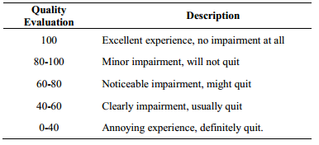
Appendix(1)
Evaluation Standard

Slide 19
Appendix(2)
GT value of Form 1,2,3
Formula to calculate DASH-MOS score
Form1 | Form2 | Form3
0.5076 | 0.6003 | 0.5646

